Slide 1

Vivekanand Education Society’s Institute Of Technology
Department Of Information Technology
Project Review II
Title: SCHOOL MANAGEMENT SYSTEM
Domain: Desktop Application
Group Members:
Member1 : Manish Makhija
Member2: Rinki Tejwani
Member3: Vanita Daryani
Mentor Name: KAJAL JEWANI

Slide 2
Content
Introduction to the project
Problem Statement
Objectives of the project
Requirements of the system (Hardware, software)
ER diagram of the proposed system
Front End
Implementation
Gantt Chart
Conclusion
References

Slide 3

Introduction to Project
Maintaining and keeping track of school administrative activities is not an easy process in the fast-growing world. It requires hard work and often it is time-consuming.
To better perform the school administrative activities of educational institute , educational institutes utilizes School Management software nowadays.
r Rates

Slide 4
Problem Statement
School Management System application offers many features that help to enhance the performance of schools with minimum efforts. School Management software does it by avoiding the manual paper works and automation of many academic and administrative activities that saves a lot of time.
r Rates

Slide 5



Objectives of the project
Maintaining Students' Attendance.
Record of Students' Result
Students' Fees Status

Slide 6
Requirements of the system (Hardware, software)
Ram - Minimum 4GB
Intel i3
Operating System - Windows 7/8.1/10
Java runtime environment - Java version: jdk 16
Database - MySQL Workbench
lem SRam -Ram - 4GB
Hard Disk - 20GB
Operating System - Windows 7/8.1/10
4GB
Hard Disk - 20GB
Operating System - Windows 7/8.1/10
tatement
Problem Statement

Slide 7
ER diagram of the proposed system
link

Slide 8
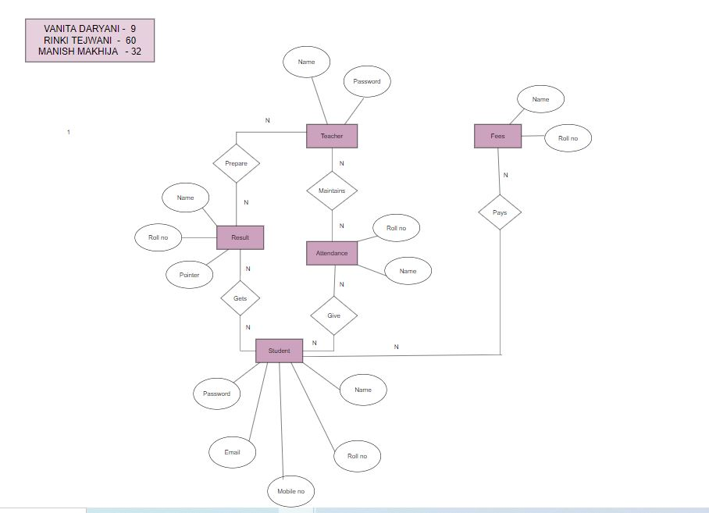

Slide 9
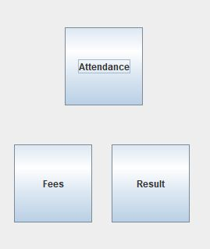
Front End
JAVA SWINGS

Slide 10
Implementation
The major outputs of project are...
Attendance record
Fee's status
Results

Slide 11
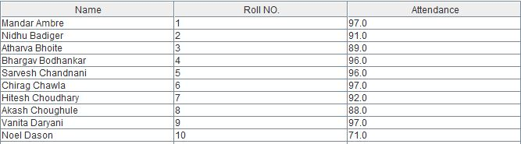
Implementation of Attendance

Slide 12
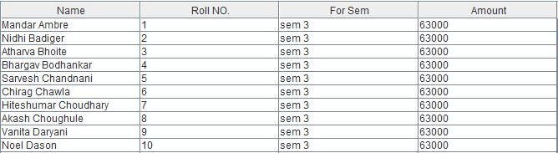
Implementation of Fees

Slide 13
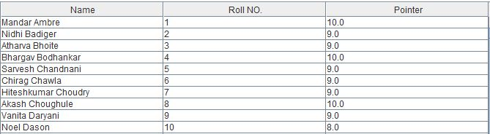
Implementation of Results

Slide 14
Gantt Chart
linkhttps://docs.google.com/spreadsheets/d/1gnn-9HuxmFoVdmvzSNKM0XJNfYth3z2bWv3mNeoFJ_w/edit?usp=sharing
Notes:
The max flow algorithm in the visualization is :-

Slide 15
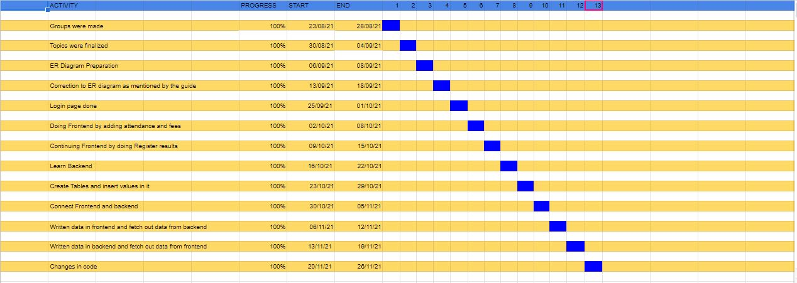

Slide 16
Conclusion
Automation of these process makes the school administration effortless thereby ensuring the smooth functioning of the school.
Helpful to perform paperless work and manage all data
Provides easy, accurate, unambiguous and faster data access.

Slide 17
References
Nptel lectures
Youtube videos
Javatpoint
Geeksforgeeks
Tutorialspoint

